Slide 1
CONTENT DELIVERY NETWORK
Submitted by:
Hongyi Guo,
Dimple Modugula,
Wentao Lu,
Scott Fontenarosa

Slide 2
Content Delivery Network -a system of computers networked together across internet that accelerates the delivery of WebPages , audio, video and other internet based content to the users around the world. CDN replicates the content provider’s files in servers.

Slide 3
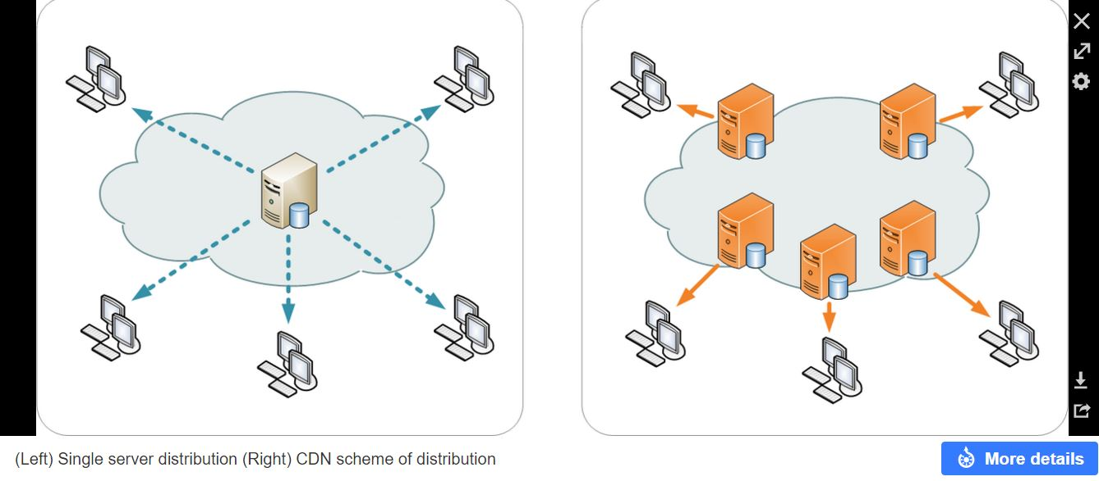

Slide 4
THE COMPONENTS OF CDN
The origin server and a set of edge servers or cache servers
The request-routing component that is responsible for directing client requests to appropriate cache servers
Distribution component that moves contents from the origin server to the cache servers
Accounting component that maintains logs of client accesses and records he usage of CDN servers

Slide 5
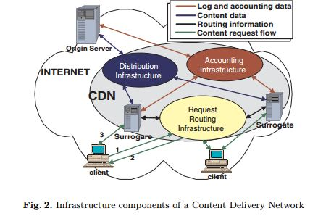

Slide 6
TYPES OF SERVICES
Web Acceleration- CDN can increase the acceleration by pressing down the nodes in its own network
Streaming and Download-Video uses network bandwidth and coverage, and many customers use it for only CDN service streaming video for internet users
Hybrid CDN(Peer to Peer)-CDN requires peer to peer processing, the client requires software to be installed to the user or pre-installed on your computer decryption

Slide 7
Search Engine Optimization
Reservation for refusal- CDN technology provides redundancy for fail-safe protection on the internet.

Slide 8
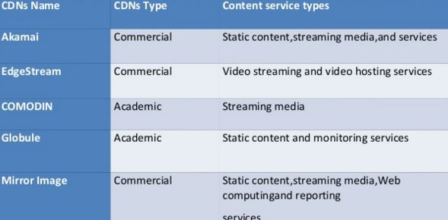
TYPES OF CDN

Slide 9
Advantages for using CDN
Faster loading
Optimize live delivery
File mirroring
Minimize packet loss
Less pressure on hosting server

Slide 10
References
http://wwwusers.di.uniroma1.it/~novella/myhome/Home_Page_di_Novella_Bartolini/papers/CDN_tutorial.pdf
http://www.hit.bme.hu/~jakab/edu/litr/CDN/CDN-Taxonomy.pdf
http://www.webperformancetoday.com/2013/06/12/11-faqs-content-delivery-networks-cdn-web-performance/
https://en.wikipedia.org/wiki/Content_delivery_network
http://ieeexplore.ieee.org/xpls/abs_all.jsp?arnumber=1250586

Slide 11
THANK YOU

